Slide 1
Ch.4 Discrete Probability Distributions(이산확률분포)
Updated: October 20, 2016
Choi, Kwanghoon
Dept. of Electronics and Computer Engineering
Chonnam National University

Slide 2
This Lecture
Discrete Probability Distributions(이산확률분포)
Discrete uniform distribution(4.1 이산균등분포)
Bernoulli distribution(4.3 베르누이 분포)
Binomial distribution(4.3 이항분포)
Geometric distribution(4.4 기하분포)
Negative binomial distribution(4.4 음이항분포)
Hypergeometric distribution(4.2 초기하분포)
Poisson distribution(4.5 푸아송분포)
Multinomial distribution(4.6 다항분포)

Slide 3
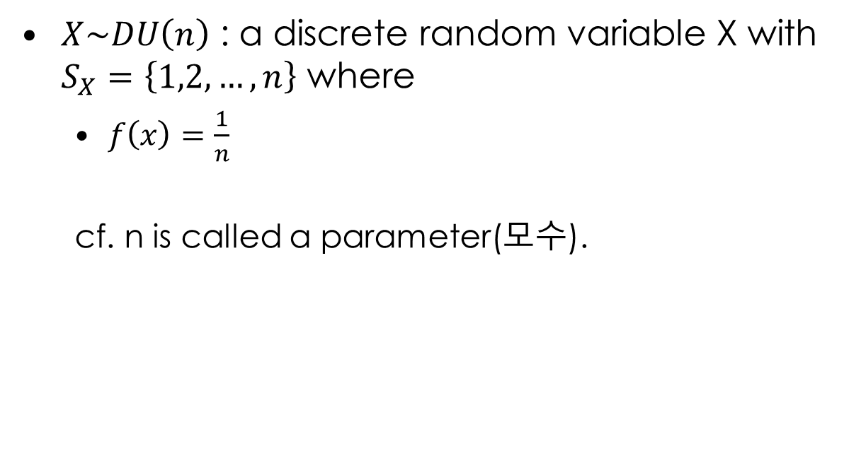
4.1 Discrete Uniform Distribution
$X\sim DU\left(n\right)$ : a discrete random variable X with $S_{X}=\left\{1,2,…,n\right\}$ where
$f\left(x\right)=\frac{1}{n}$
cf. n is called a parameter(모수).

Slide 4
4.1 Discrete Uniform Distribution
Activity1(예제1) In a bag, there are ten cards, numbered from 1 to 10.
Let X be the number of a card you choose.
The p.m.f of X?
E(X), Var(X)?
Probability that you choose a card with the number >=7.

Slide 5
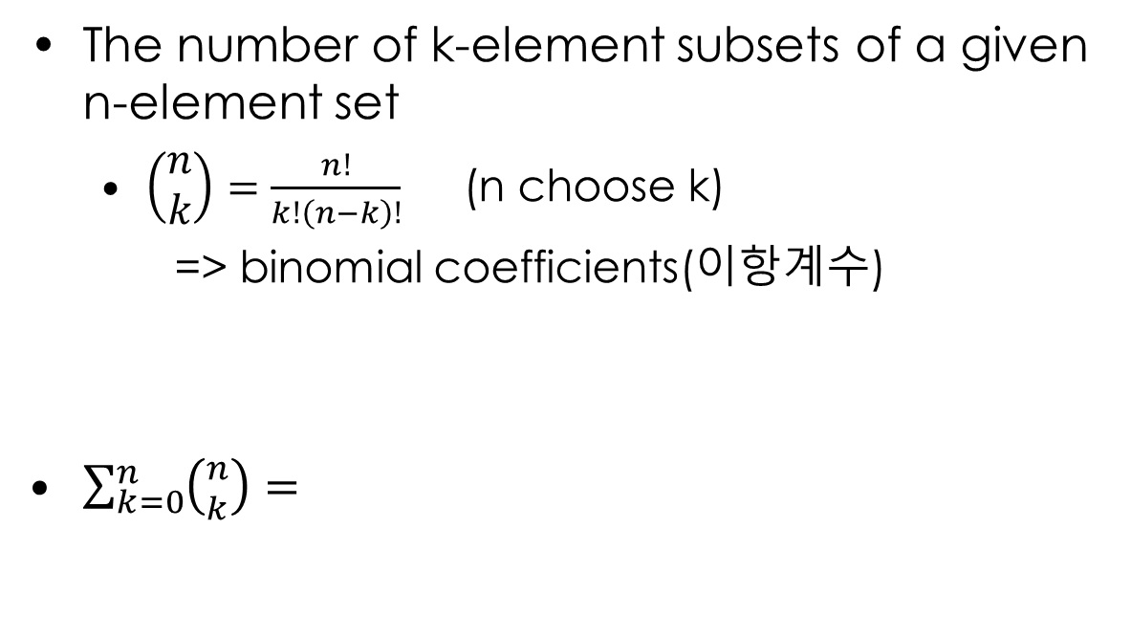
4.3 Binomial Distribution(이항분포)
The number of k-element subsets of a given n-element set
$\left(\begin{matrix}n \\ k\end{matrix}\right)=\frac{n!}{k!\left(n−k\right)!}$ (n choose k)
=> binomial coefficients(이항계수)
$\sum_{k=0}^{n}{\left({n \atop k}\right)=}$

Slide 6
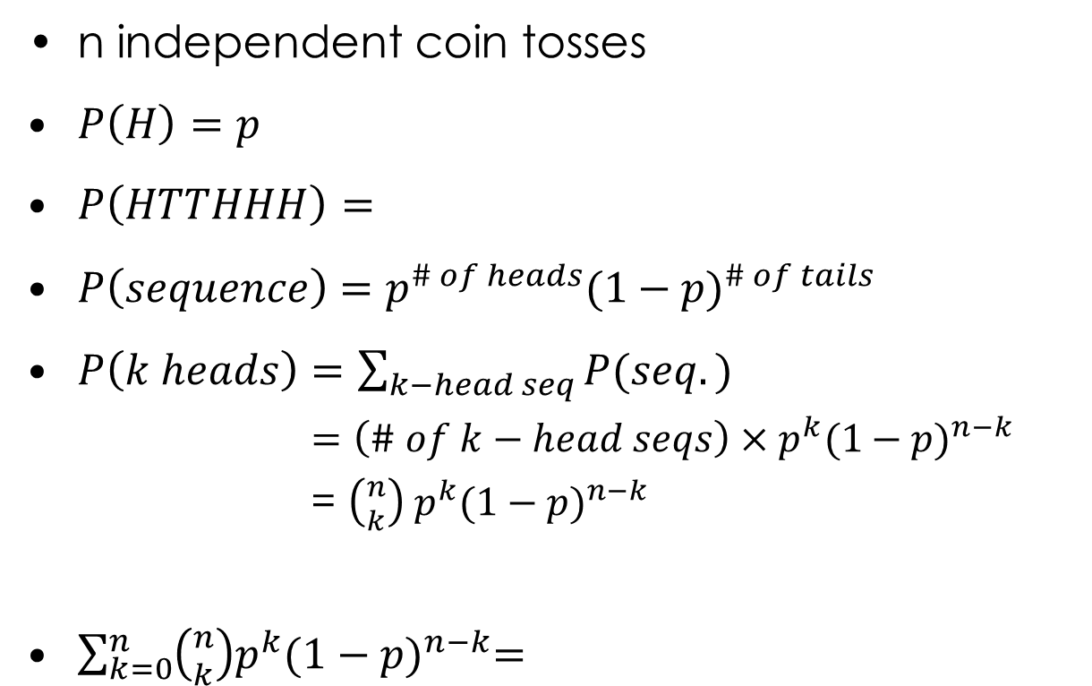
4.3 Binomial Distribution(이항분포)
n independent coin tosses
$P\left(H\right)=p$
$P\left(HTTHHH\right)=$
$P\left(sequence\right)=p^{\# of heads}{(1−p)}^{\# of tails}$
$P\left(k heads\right)=\sum_{k−head seq}{P(seq.)}$
$=\left(\# of k−head seqs\right)×p^{k}{(1−p)}^{n−k}$
= $\left({n \atop k}\right) p^{k}{(1−p)}^{n−k}$
$\sum_{k=0}^{n}{\left({n \atop k}\right)p^{k}{(1−p)}^{n−k}=}$

Slide 7
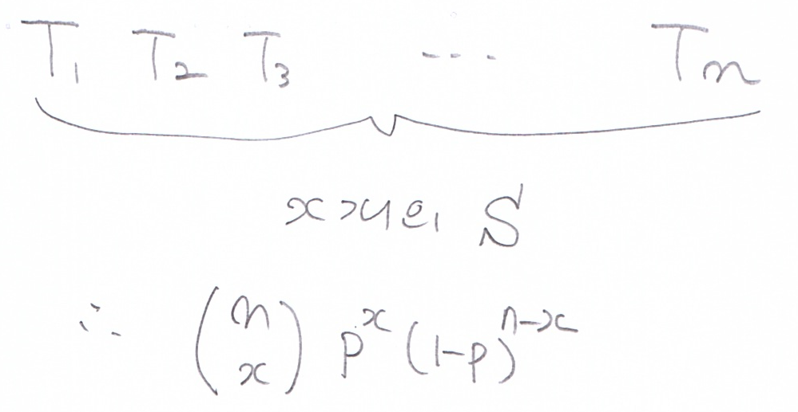
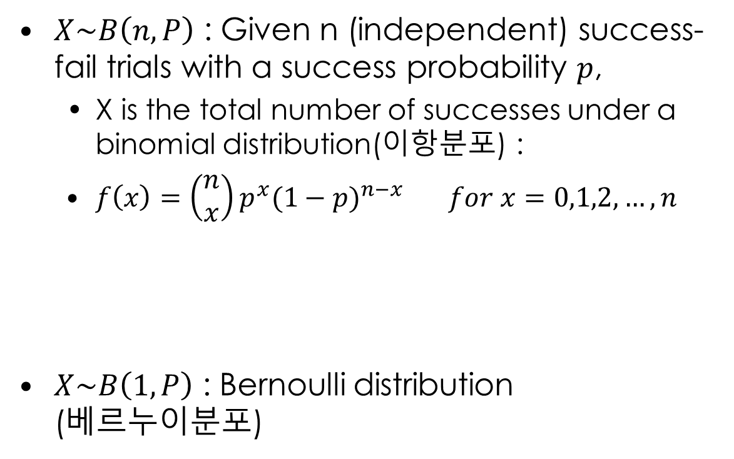
4.3 Binomial Distribution(이항분포)
$X\sim B\left(n,P\right)$ : Given n (independent) success-fail trials with a success probability $p$,
X is the total number of successes under a binomial distribution(이항분포) :
$f\left(x\right)=\left(\begin{matrix}n \\ x\end{matrix}\right)p^{x}{(1−p)}^{n−x} for x=0,1,2,…,n$
$X\sim B\left(1,P\right)$ : Bernoulli distribution (베르누이분포)

Slide 8
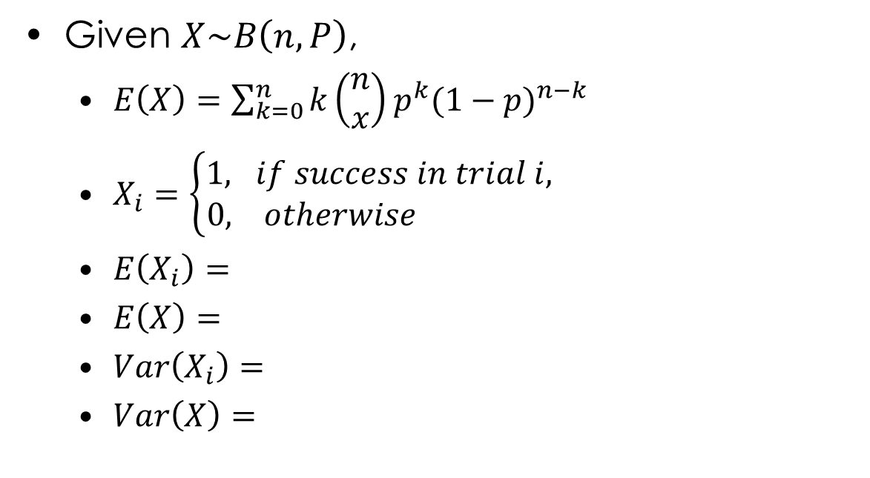
4.3 Binomial Distribution(이항분포)
Given $X\sim B\left(n,P\right)$,
$E\left(X\right)=\sum_{k=0}^{n}{k\left(\begin{matrix}n \\ x\end{matrix}\right)p^{k}{(1−p)}^{n−k}}$
$X_{i}=\left\{\begin{aligned}1, if success in trial i, \\ 0, otherwise \end{aligned}\right.$
$E\left(X_{i}\right)=$
$E\left(X\right)=$
$Var\left(X_{i}\right)=$
$Var\left(X\right)=$

Slide 9
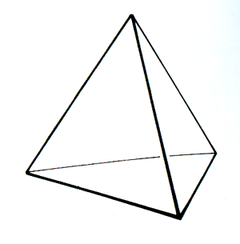
4.3 Binomial Distribution(이항분포)
Activity1(예제3). Tossing five times a tetrahedron(사면체) where each face is numbered from 1 to 4,
let X be how many times the number 1 comes up.
The p.m.f. of X?
E(X), Var(X)?

Slide 10
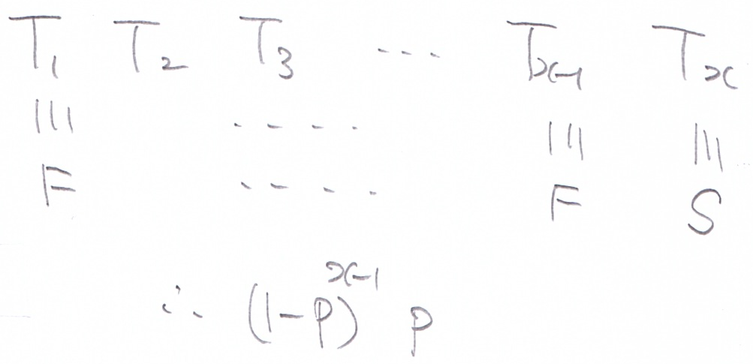
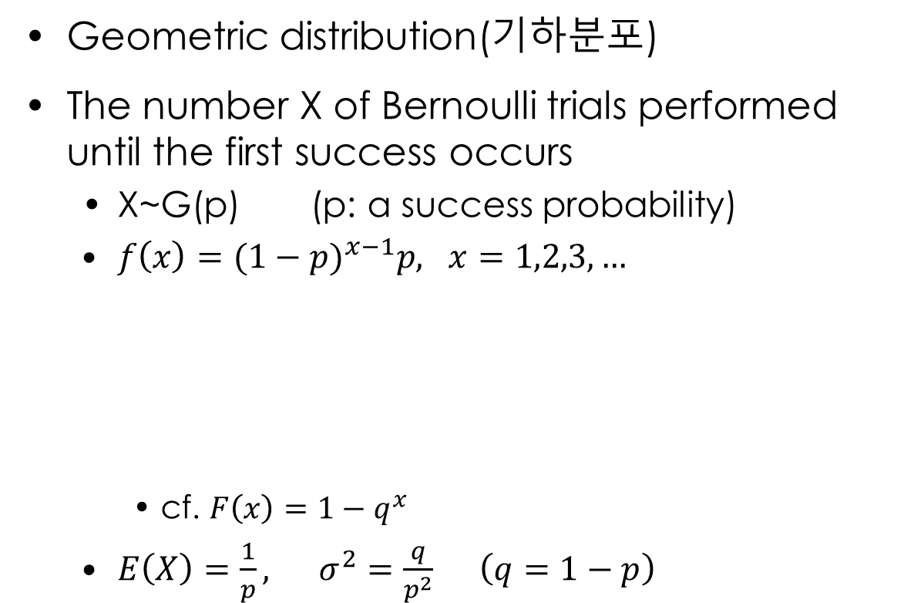
4.4 Geometric Distribution and Negative Binomial Distribution (기하분포와 음이항분포)
Geometric distribution(기하분포)
The number X of Bernoulli trials performed until the first success occurs
X~G(p) (p: a success probability)
$f\left(x\right)={(1−p)}^{x−1}p, x=1,2,3,…$
cf. $F\left(x\right)=1−q^{x}$
$E\left(X\right)=\frac{1}{p}, σ^{2}=\frac{q}{p^{2}} \left(q=1−p\right)$

Slide 11
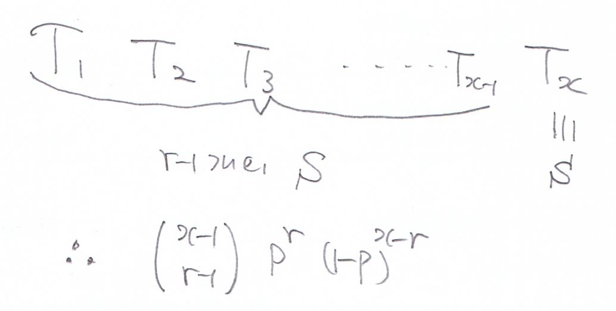
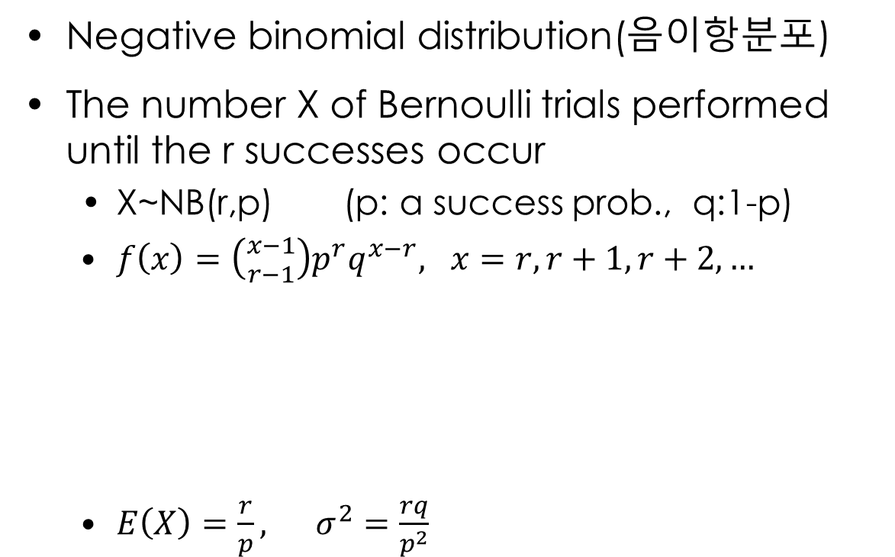
4.4 Geometric Distribution and Negative Binomial Distribution (기하분포와 음이항분포)
Negative binomial distribution(음이항분포)
The number X of Bernoulli trials performed until the r successes occur
X~NB(r,p) (p: a success prob., q:1-p)
$f\left(x\right)=\left({x−1 \atop r−1}\right)p^{r}q^{x−r}, x=r,r+1,r+2,…$
$E\left(X\right)=\frac{r}{p}, σ^{2}=\frac{rq}{p^{2}}$

Slide 12
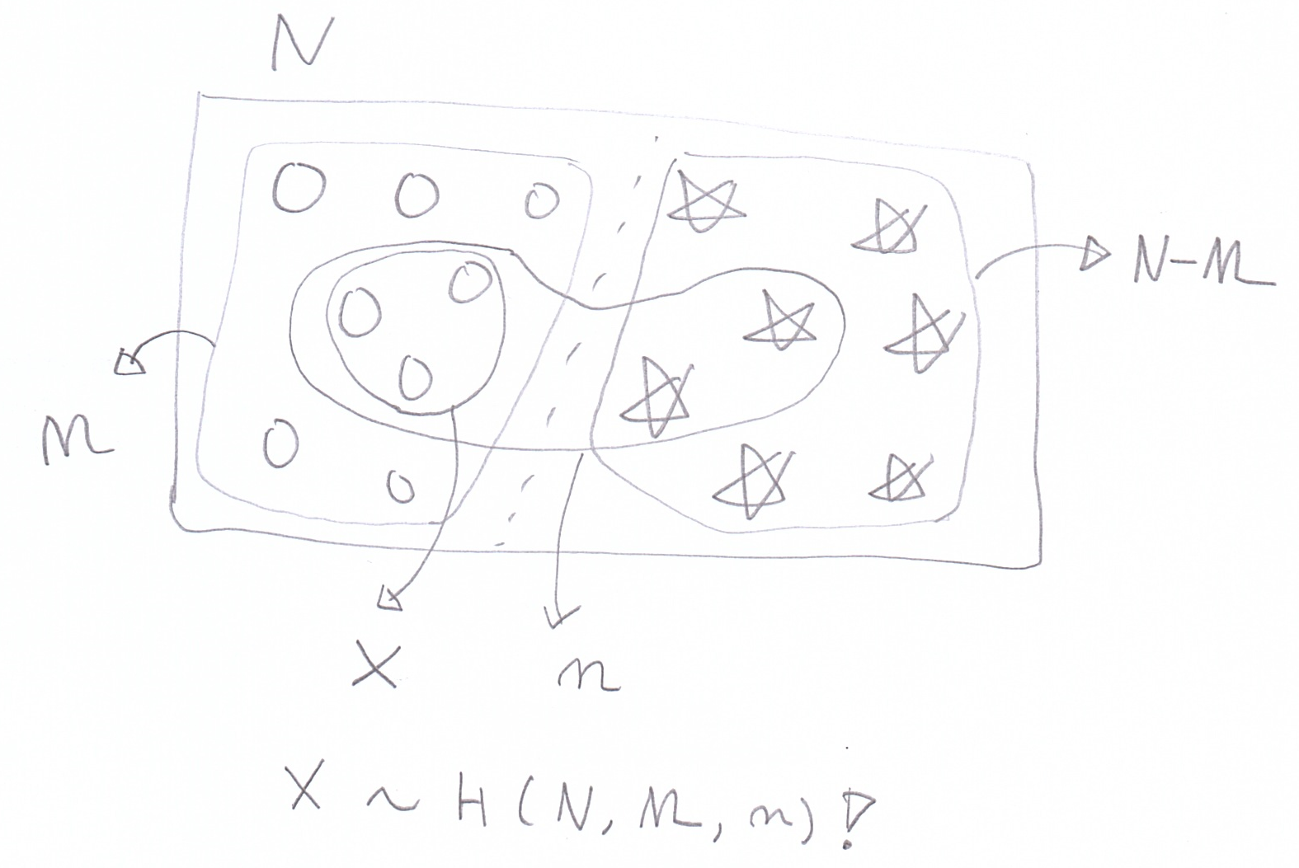
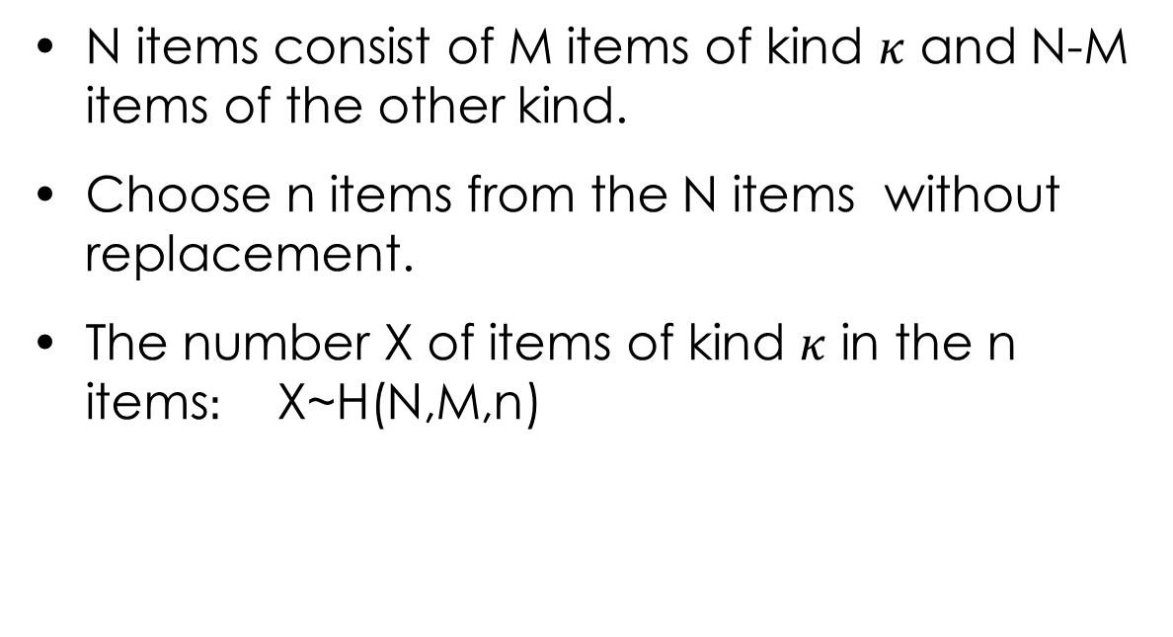
4.2 Hypergeometric Distribution (초기하분포)
N items consist of M items of kind $κ$ and N-M items of the other kind.
Choose n items from the N items without replacement.
The number X of items of kind $κ$ in the n items$:$ X~H(N,M,n)

Slide 13
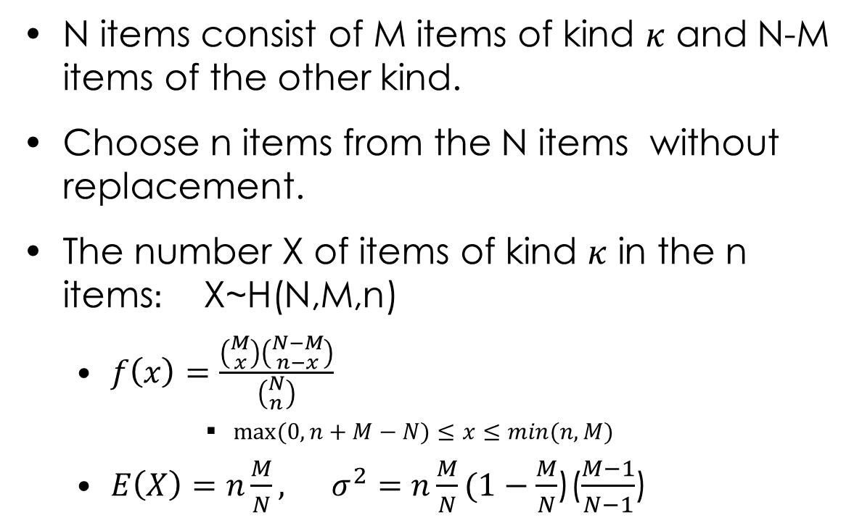
4.2 Hypergeometric Distribution (초기하분포)
N items consist of M items of kind $κ$ and N-M items of the other kind.
Choose n items from the N items without replacement.
The number X of items of kind $κ$ in the n items$:$ X~H(N,M,n)
$f\left(x\right)=\frac{\left({M \atop x}\right)\left({N−M \atop n−x}\right)}{\left({N \atop n}\right)}$
$max⁡(0,n+M−N)≤x≤min(n,M)$
$E\left(X\right)=n\frac{M}{N}, σ^{2}=n\frac{M}{N}(1−\frac{M}{N}$)($\frac{M−1}{N−1}$)

Slide 14
4.2 Hypergeometric Distribution (초기하분포)
Activity1 (예제1, P.132)
A bag has 10 coins in total.
Only four of them are 100 won coins.
You choose five coins from the bag.
X is the number of 100 won coins of the five chosen coins.
What is the p.m.f of X?

Slide 15
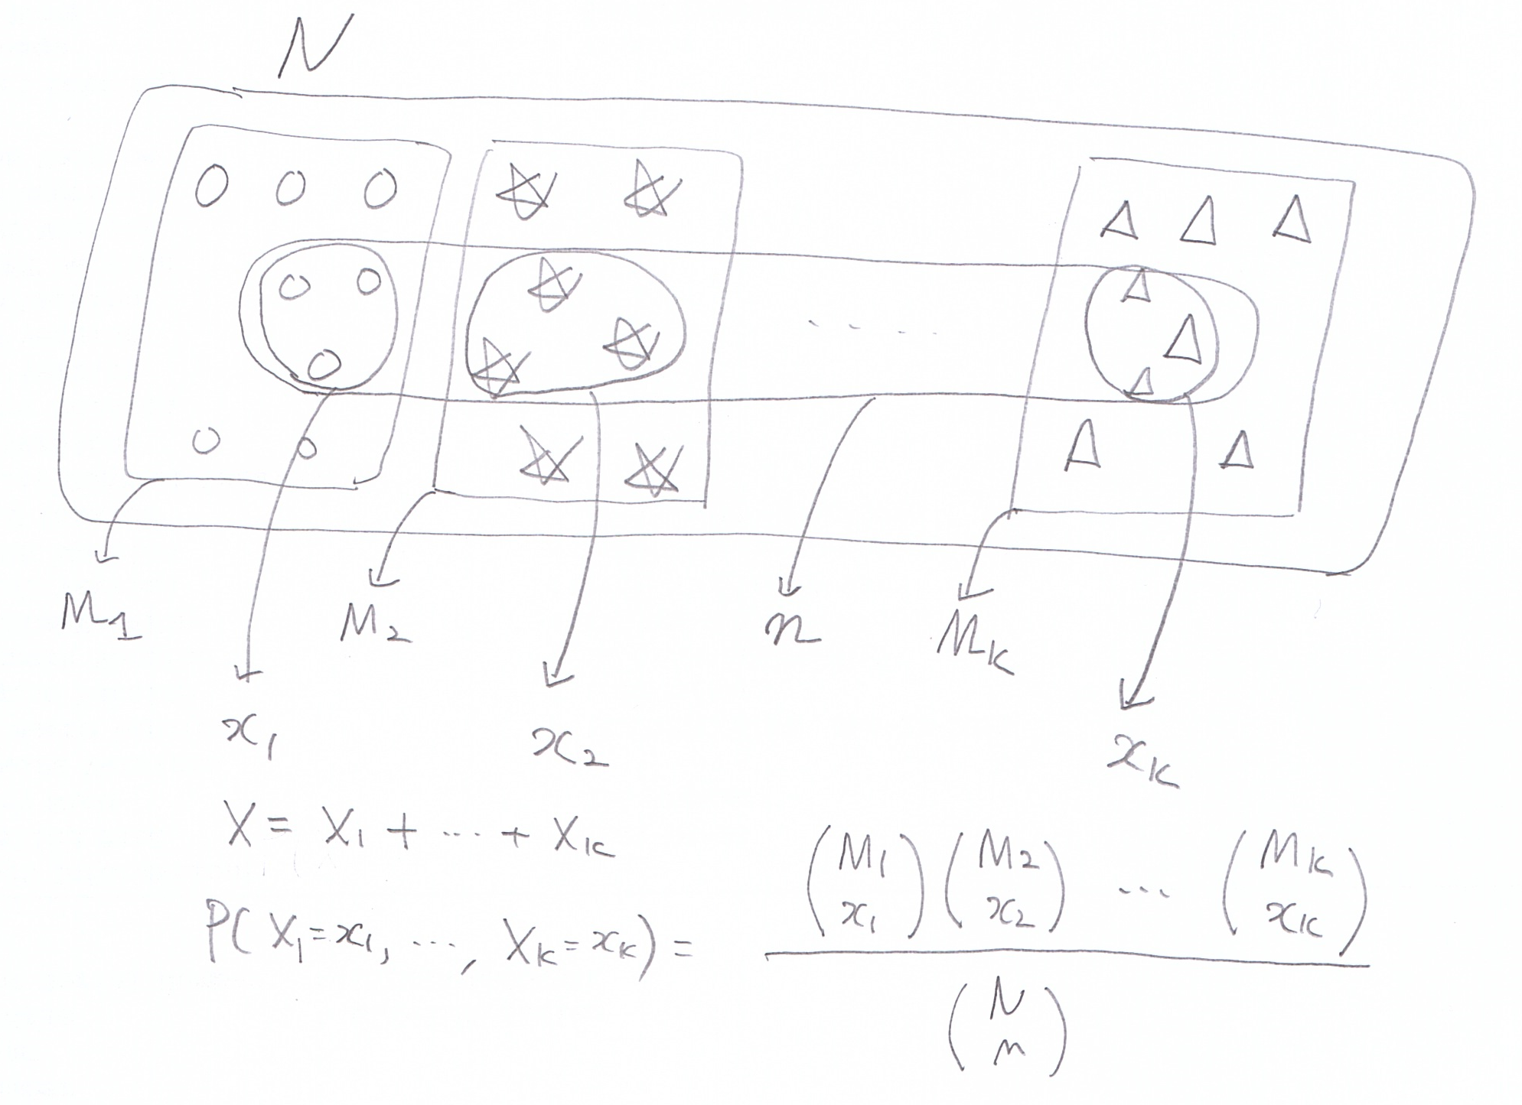
4.2 Hypergeometric Distribution (초기하분포)
Multivariate hypergeometric distribution (다변량 초기하분포)

Slide 16
4.2 Hypergeometric Distribution (초기하분포)
Activity2 (예제2, P.134)
8 red balls, 10 blue balls, and 10 yellow balls are in a bag.
You take out 10 balls from the bag.
X, Y, and Z are how many red, blue, and yellow balls are in the 10 balls, respectively.
What is the joint p.m.f of X, Y, and Z?

Slide 17
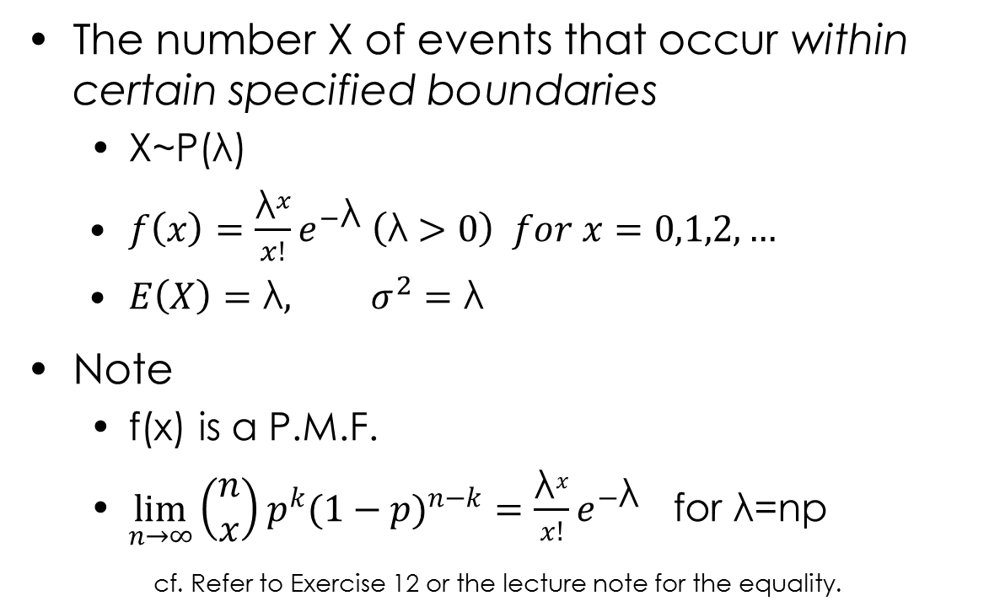
4.5 Poisson Distribution (푸아송분포)
The number X of events that occur within certain specified boundaries
X~P(λ)
$f\left(x\right)=\frac{{\text{λ}}^{x}}{x!}e^{−\text{λ}} \left(\text{λ}>0\right) for x=0,1,2,…$
$E\left(X\right)=\text{λ}, σ^{2}=\text{λ}$
Note
f(x) is a P.M.F.
$\lim_{n→∞}{{\left(\begin{matrix}n \\ x\end{matrix}\right)p}^{k}{(1−p)}^{n−k}}=\frac{{\text{λ}}^{x}}{x!}e^{−\text{λ}}$ for $\text{λ}\text{=}\text{np}$
cf. Refer to Exercise 12 or the lecture note for the equality.

Slide 18
4.5 Poisson Distribution (푸아송분포)
Activity1
Suppose that the number of errors in a piece of software has a Poisson distribution with λ=3.
The expected number of errors is three.
P(X=0)=
P(X>=3)=

Slide 19
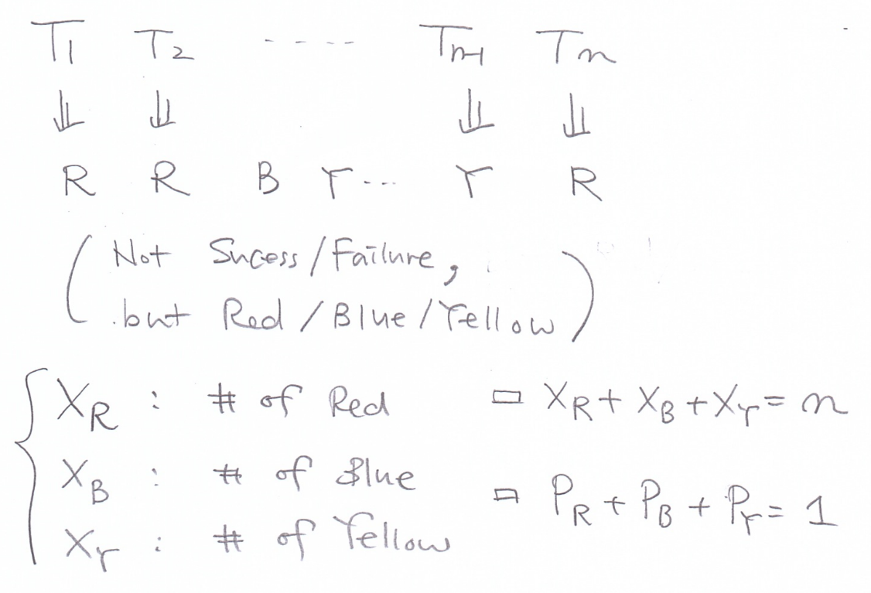

4.6 Multinomial Distribution (다항분포)
Each of the trials can have k outcomes with probabilities $p_{i}$ s.t. $p_{1}+…+p_{k}=1.$
$X_{1},…,X_{k}$ are the numbers of occurrences of each outcome: $X_{1},…,X_{k}\sim Mult(n,p_{1}$,…, $p_{k})$

Slide 20
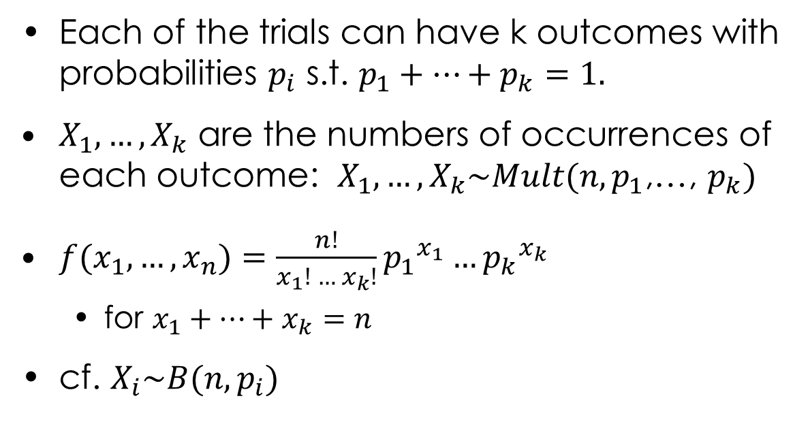
4.6 Multinomial Distribution (다항분포)
Each of the trials can have k outcomes with probabilities $p_{i}$ s.t. $p_{1}+…+p_{k}=1.$
$X_{1},…,X_{k}$ are the numbers of occurrences of each outcome: $X_{1},…,X_{k}\sim Mult(n,p_{1}$,…, $p_{k})$
$f(x_{1},…,x_{n})=\frac{n!}{x_{1}! … x_{k}!}{p_{1}}^{x_{1}}{{…p}_{k}}^{x_{k}}$
for $x_{1}+…+x_{k}=n$
cf. $X_{i}\sim B(n,p_{i})$

Slide 21
4.6 Multinomial Distribution (다항분포)
Activity1 (예제1,P169)
Three red balls, four blue balls, and three yellow balls are in a bag.
You take out five balls one by one with replacement(복원추출).
X, Y, and Z are the numbers of red, blue, and yellow balls taken out.
What is the joint p.m.f of X,Y,and Z?

Slide 22
What we have learned
A series of useful discrete probability distributions

